Slide 1
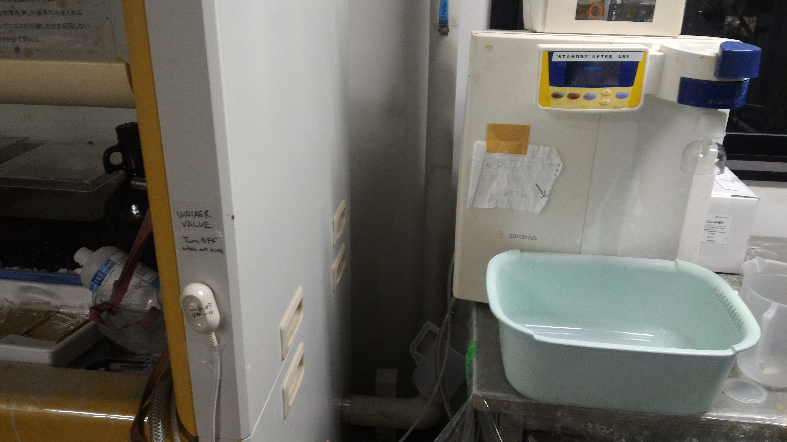
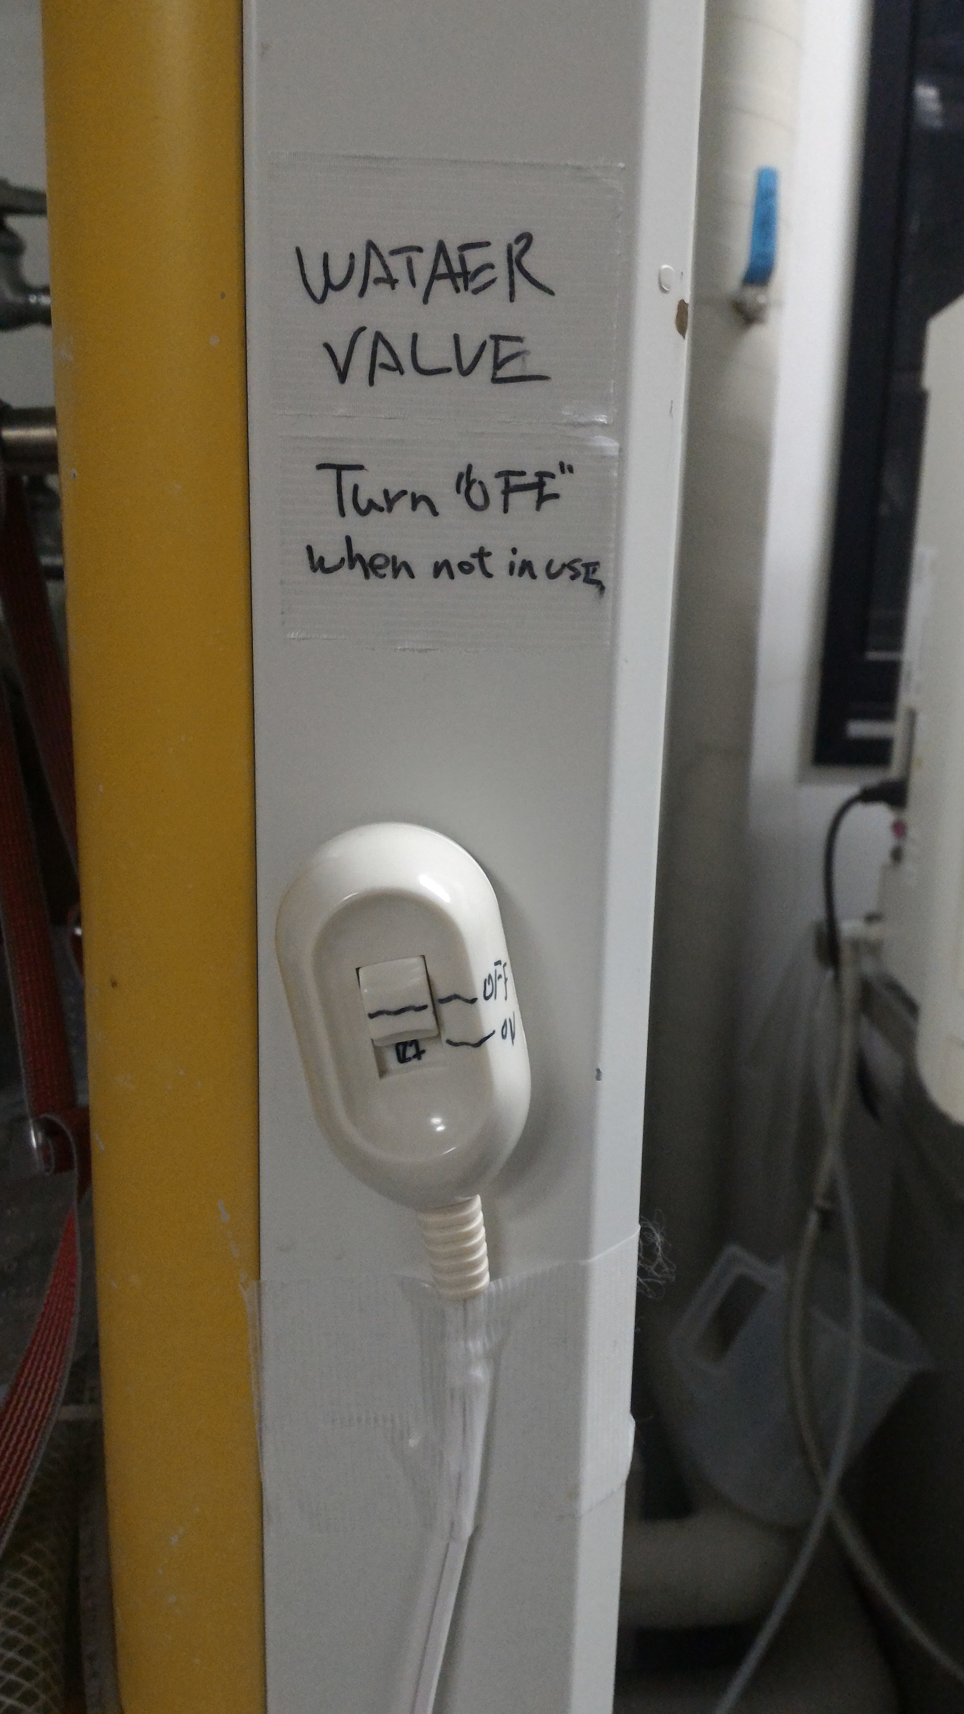
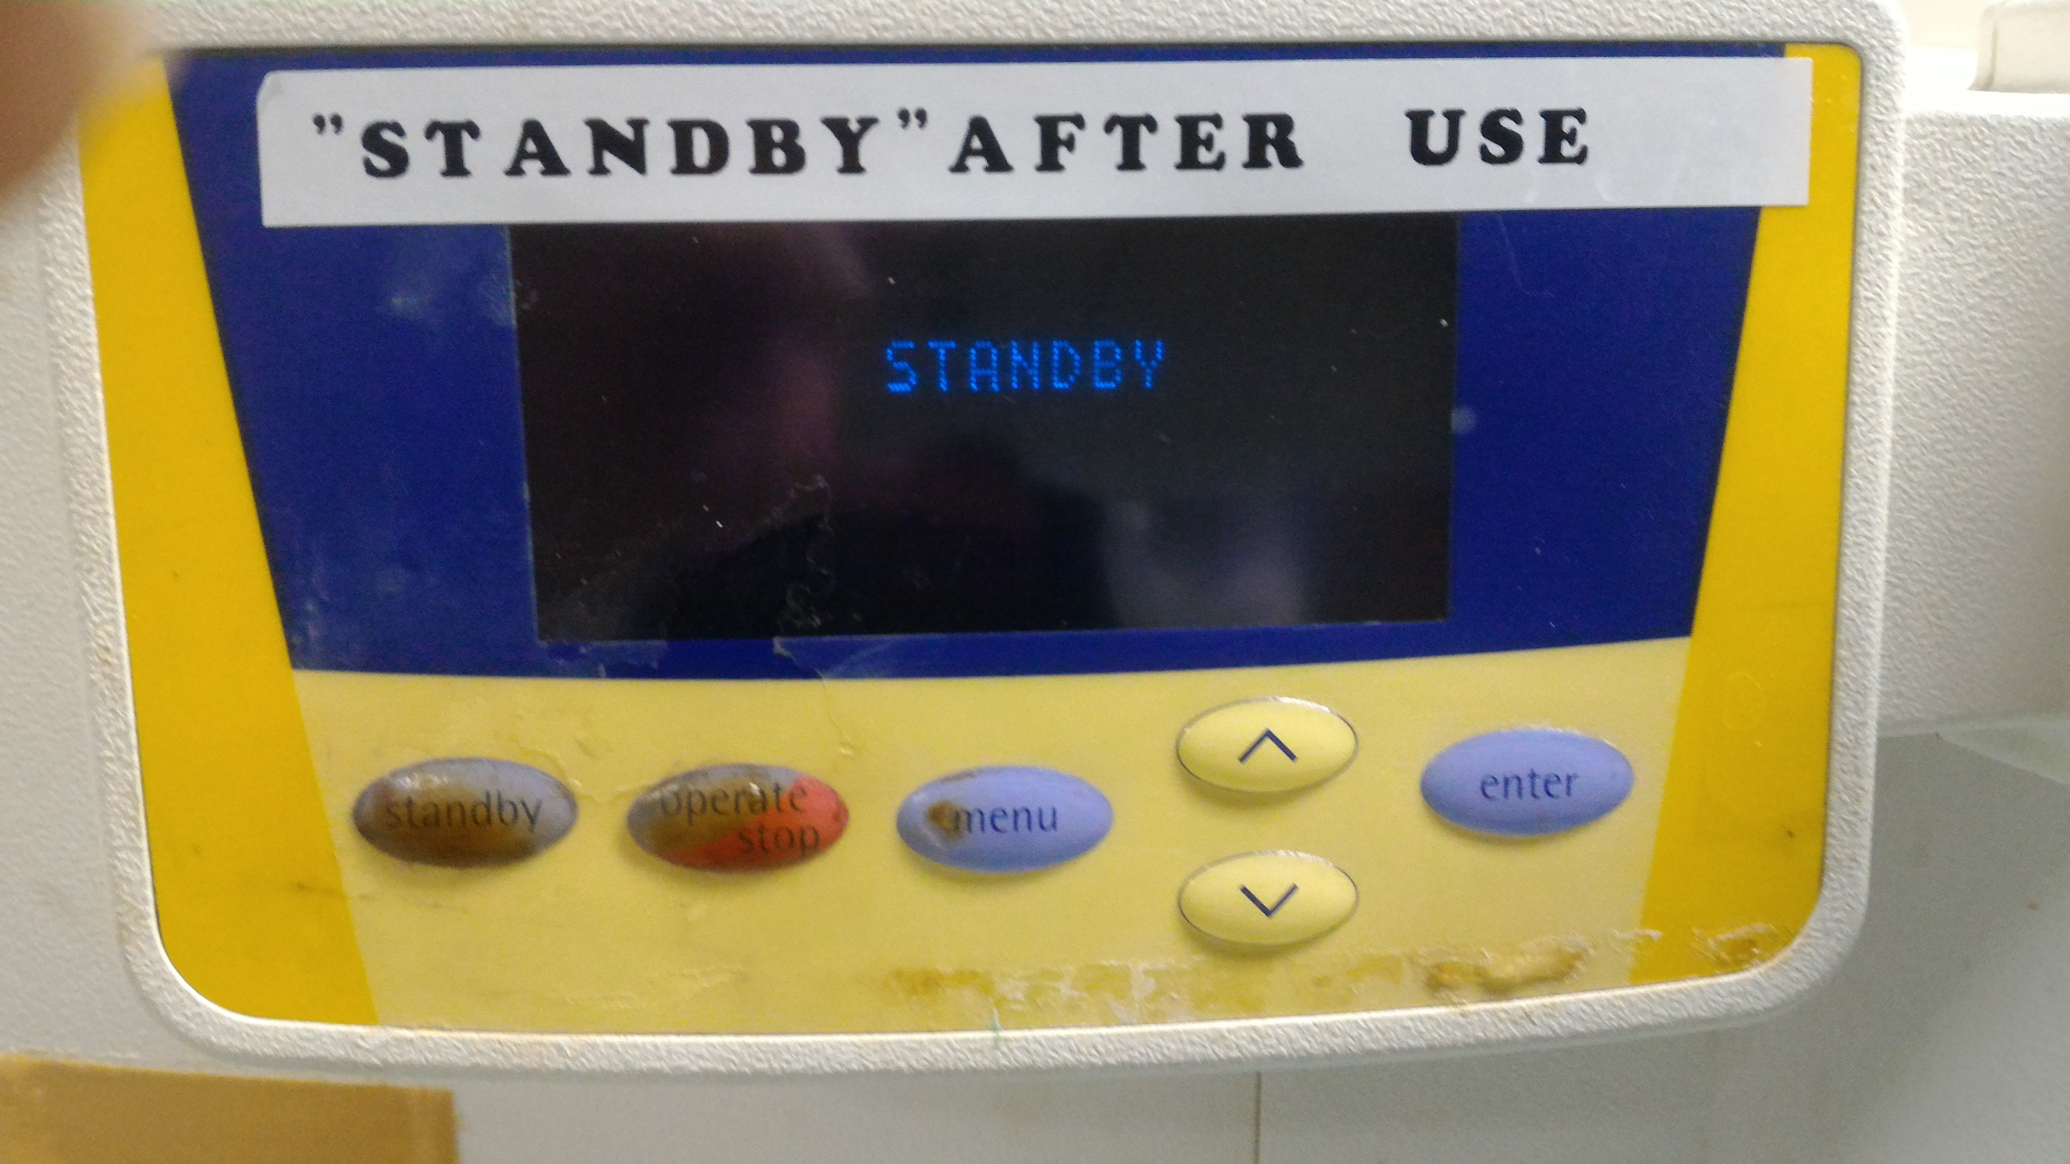
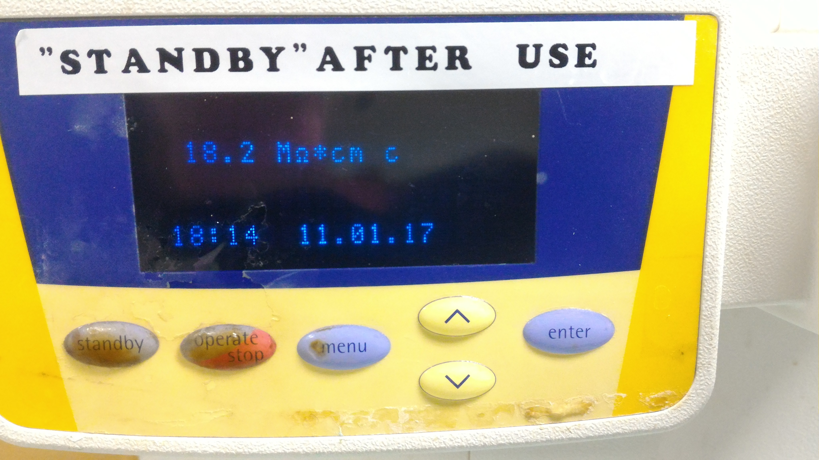
Main valve switch
1. Open the main valve
(Slide the switch to ON)
4. Push “Standby” after use
ON
2. Push “Operate”
If you leave the machine running, the pump will be damaged.
5. Close the main valve
(Slide the switch to OFF)
OFF
3. Wait until the resistivity reaches 18.2 MΩ.
If the resistivity does not reach 18.2Mohm, filters needs to be replaced. Let staffs know.

Slide 2
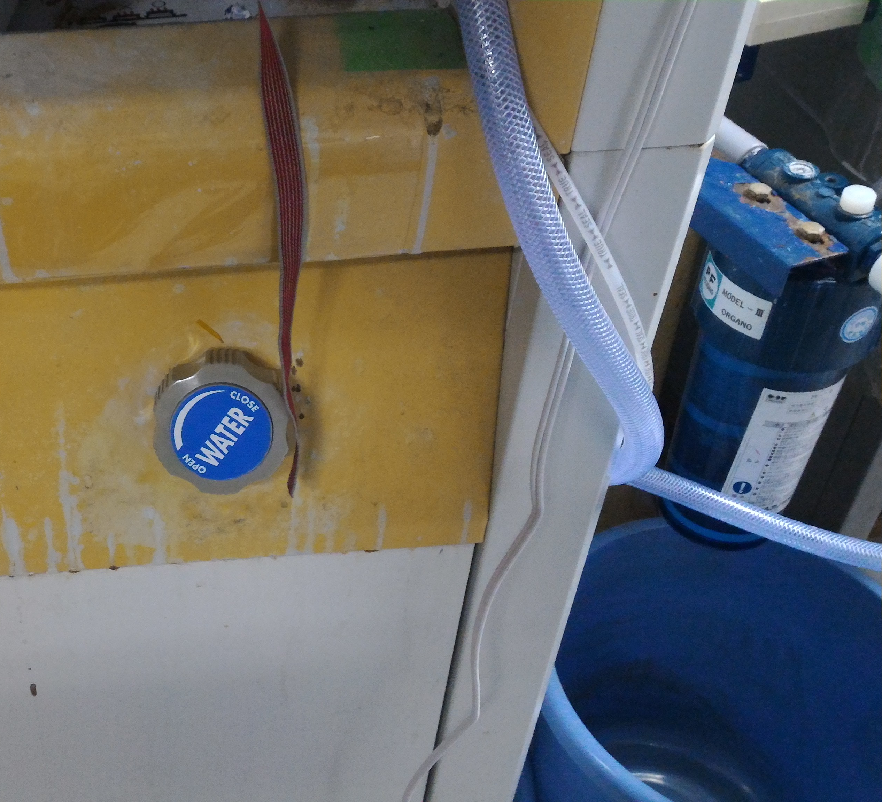
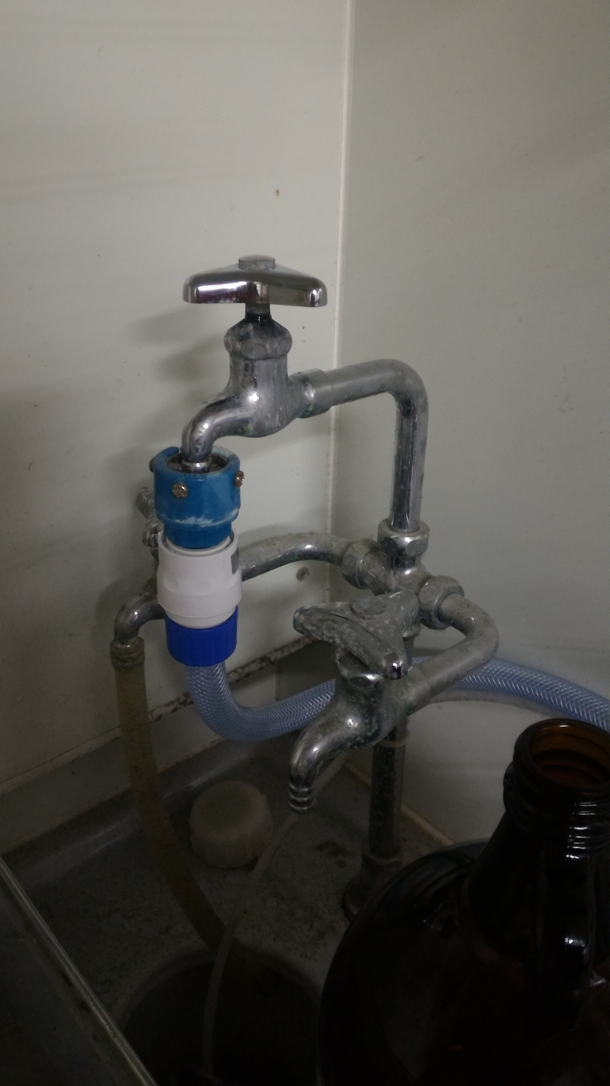
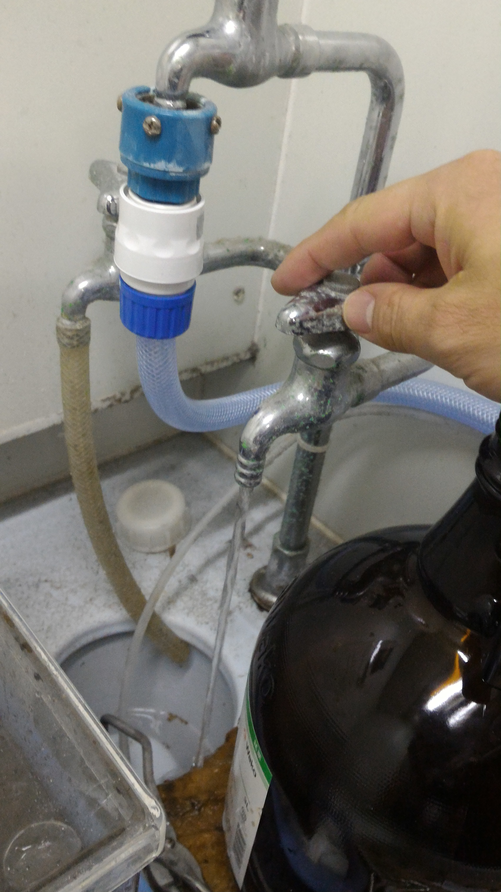
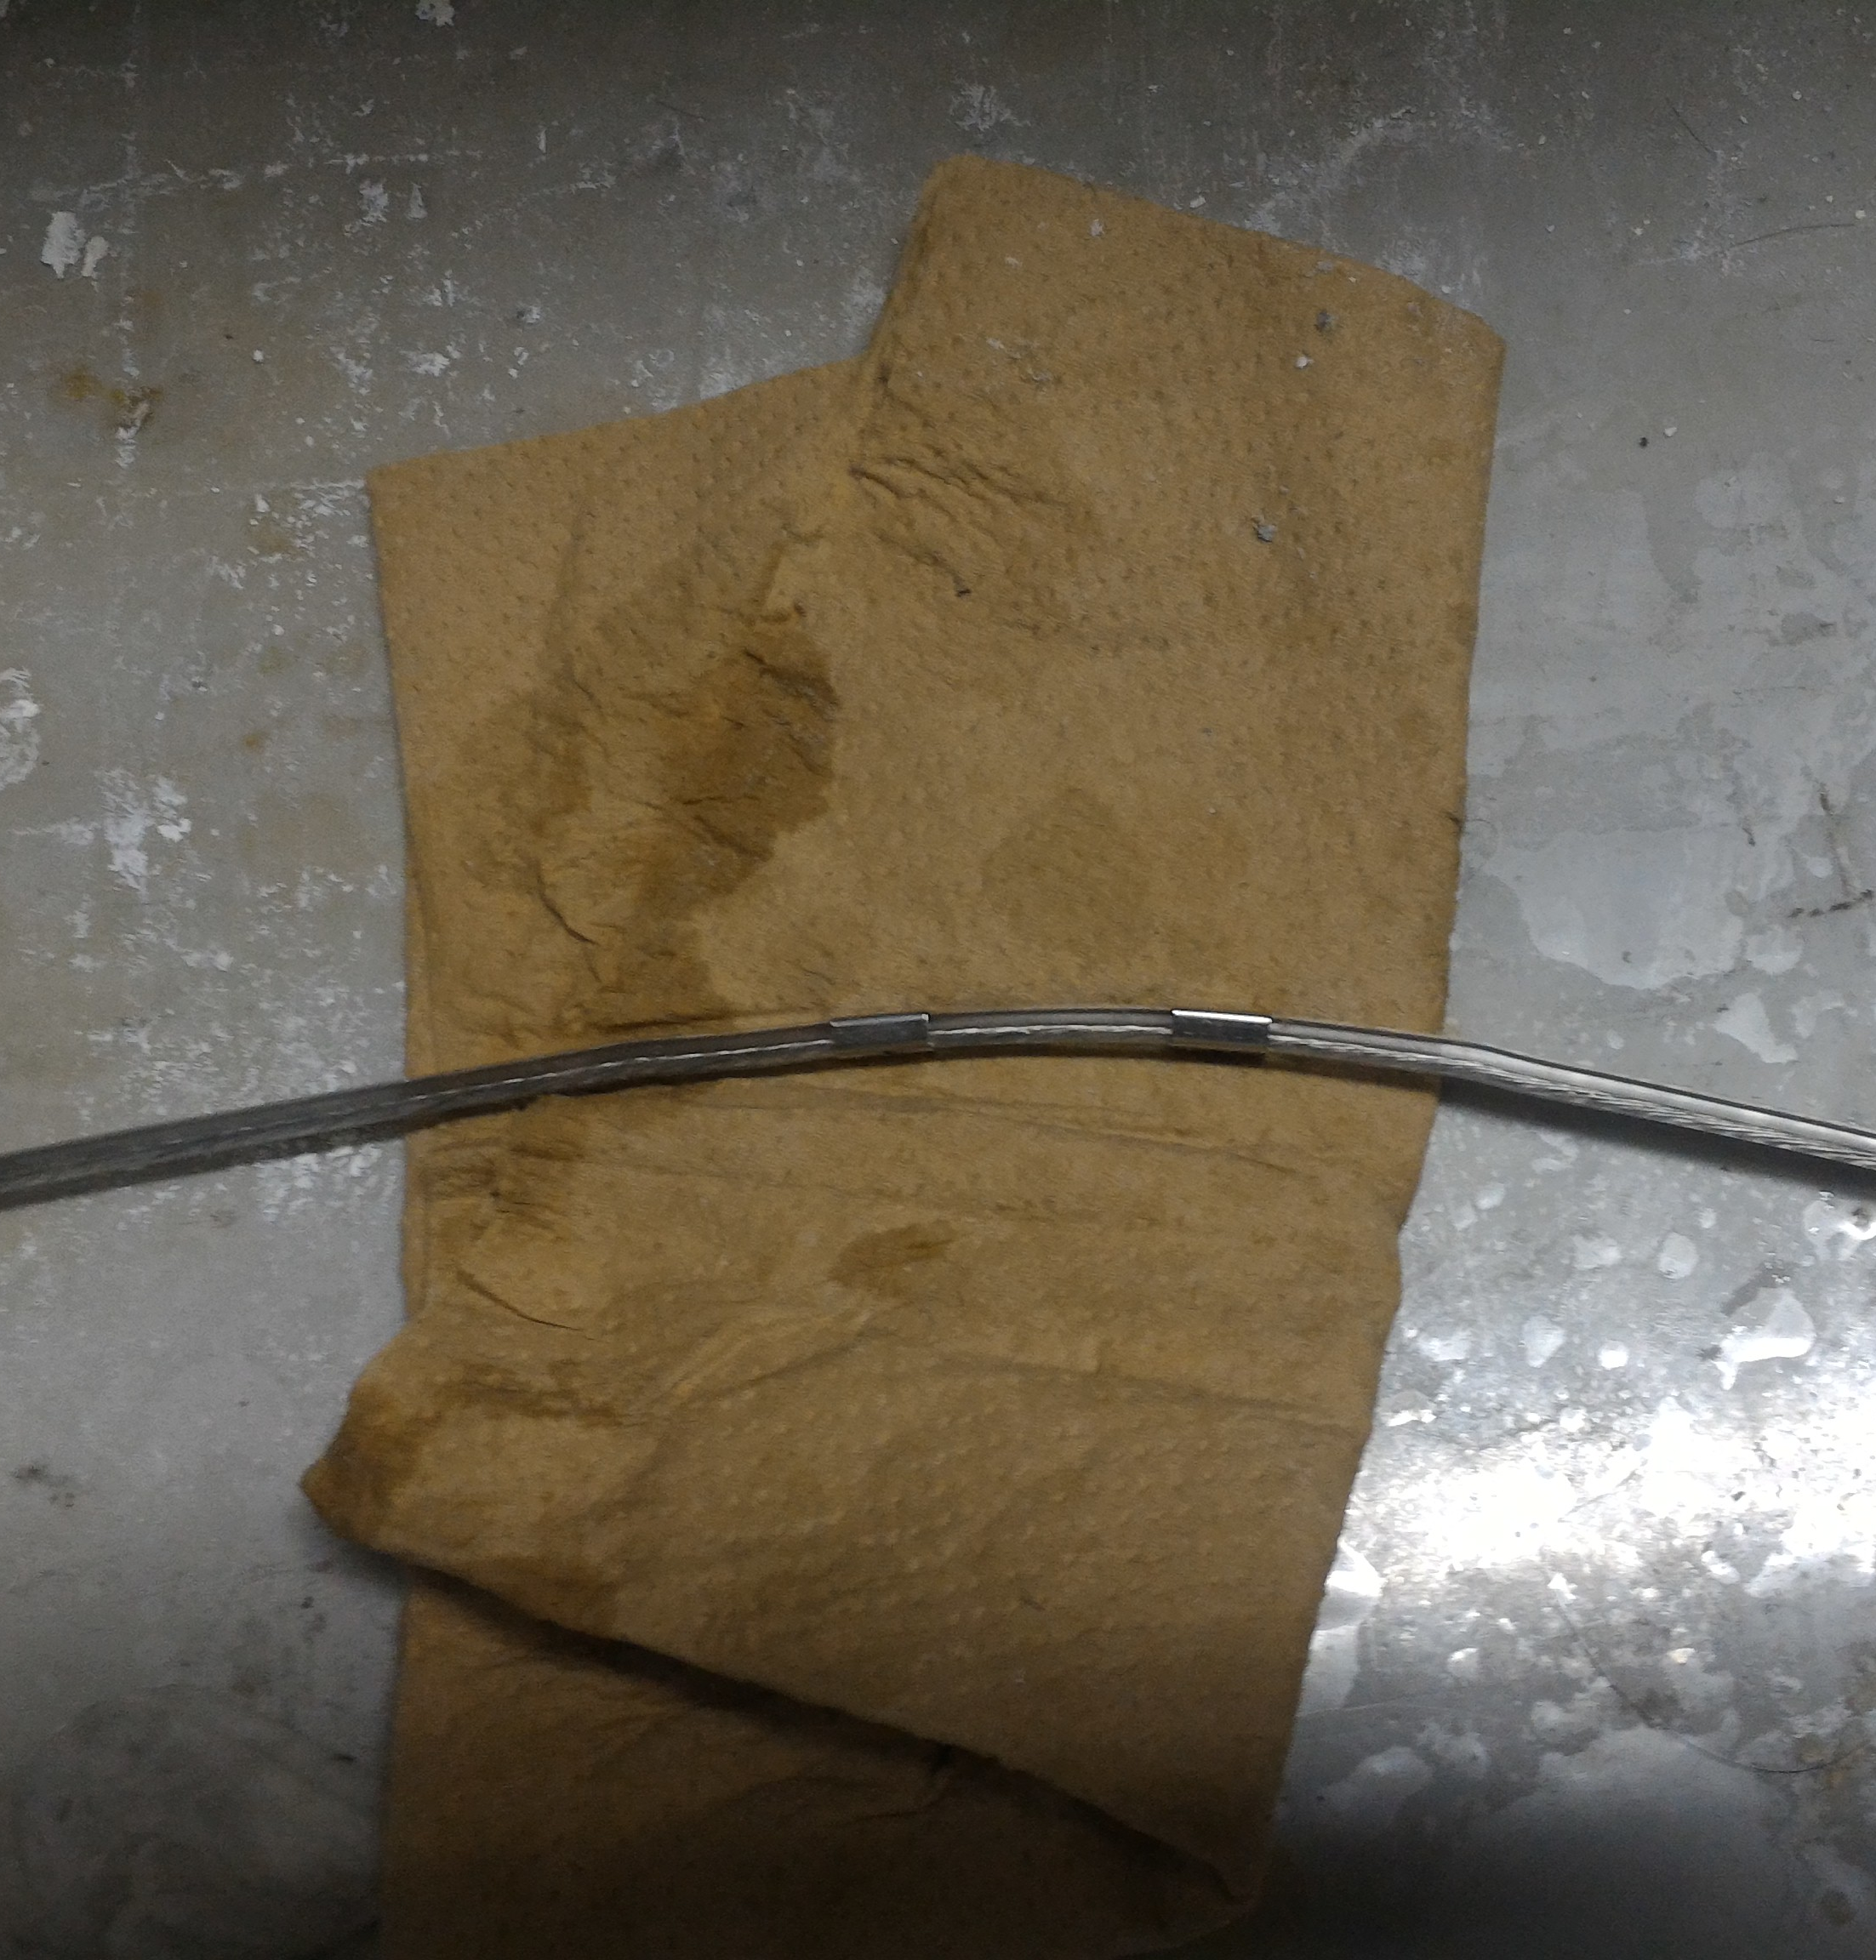
When water is not coming out..
1. Make sure the water valves are opened.
Electric valve
Manual valve
Tap
2. Make sure water is coming to the other taps.
If water is not coming to the other taps, the water leak sensor might be working.
3. Make sure the floor and the water leak sensors are not wet.
If towels on the floor is wet, the leak detector will close the electric valve.

